Slide 1
Amortized Analysis

Slide 2
An Amortized analysis is an strategy for analyzing a sequence of operations to show that the average cost per operation is small, even though a single operation within the sequence might be expensive
It refers to finding the average running time per operation over a worst case sequence of operations
It is technique for analysing algorithms under some conditions

Slide 3
Amortized analysis differs from average case performance in that probability is not involved;
In average case analysis, we are averaging over all possible inputs
Amortized analysis guarantees the time per operation over worst case performance
Amortized analysis assumes worst case input and typically does not allow random choices

Slide 4
Techniques used in Amortized Analysis
Aggregate Analysis determines the upper bound T(n) on the total cost of a sequence of n operations, then calculates the average cost to be T(n)/n
Accounting Method determines the individual cost of each operation, combining its intermediate execution time and its influence on the running time of future operations
Potential Method like an accounting method, but overcharges operations early to compensate for undercharges later
Amortized bounds
- assign amortized cost for each operations such that it “preserve the sum”
    ∑ amortized cost >= ∑ Actual cost

Slide 5
Idea is that the worst case operation can alter the state in such way that worst case cannot occur again for a long time, thus “amortizing” its cost
It is applicable to some special set of problems like hash tables, disjoint set, splay trees etc.
It has significance where first set of input affects the next set of inputs

Slide 6
Case 1: Find kth smallest element
int find_Kth _smallest ( int A[], int n, int k)
{
If (! Sorted)
Sort(A,n)
return A[k]
}
Running Time is O(n log n)

Slide 7
To find n different kth smallest element
K= 1st, 10th, 50th …..
Worst Case n* (n log n)
Amortized cost per operation
= Total cost of k operations/k
Amortized Analysis
(nlogn)+O(1)+O(1)+……….
nlogn +1+1+…..(n-1) = (nlogn+n)/n
= O(logn+1) =logn

Slide 8
Scenario – doubling the space
Ex: (Adding puppies)
If there is a space
  Add puppy in free space O(1)
  If there is no space left
  -buy a space with 2 X storage (1 unit )
  -Move all puppies in new facility ( N + 1 unit)
  -Total Cost = 1+N+1 = O(N)

Slide 9
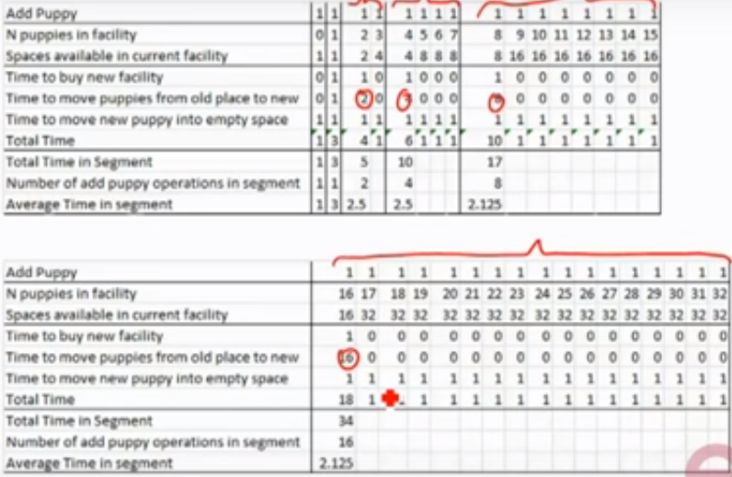

Slide 10

Observation
-it is only expensive when full
Many cheap add after expensive one
Spread out the expensive cost uniformly

Slide 11
Sequence of Operations
PUSH, POP, MULTIPOP
Actual Cost
PUSH 0(1) 1
POP 0(1) 1
Multipop (S,k) min(S,k)
Amortized analysis
PUSH 2
POP 0
Multipop (S,k) 0
Multipop(S,k)
While not stackEmpty(S) and k<>0
Do POP S
K=k-1
Total cost for n sequence of operations = 2n
Amortized cost/operation
= Total Cost / Total Ops
= 2n / n
= 2 (constant )
Therefore Effective cost per operation in constant i.e. O(1).

